Slide 1
Object-Oriented Analysis and Design using JAVA (20B12CS334)
B.Tech (CSE/IT) 5th SEM
2021-2022

Slide 2
Software complexity: benefits and understanding the challenges OOAD can address

Slide 3
Introduction to software complexity
The first challenge when talking about software complexity is to answer the question: “What is complexity?” There is no consensus on how to define software complexity. It is widely believed that software complexity cannot be described using a single dimension.
Brooks is referring to an often used classification of complexity: accidental and essential. “The complexity of software is an essential property, not an accidental one. Hence, descriptions of a software entity that abstract away its complexity often abstract away its essence.”
Essential complexity arises from the nature of the problem and how deep a skill set is needed to understand the problem. The reason is that not all complexity is essential. While some complexity is inherent to the problem, we also bring our own complexity while writing the program. This is called accidental complexity.
Brooks,Fredrick P.”The Mythical Man Month: Essays on Software Engineering.” Addison-Wesley, 1995.
Bill Curtis,”Measurement and experimentation in software engineering.” Proceedings of the IEEE, vol.68,no.9,pp.1144–1157, 1980.

Slide 4
IEEE defines software complexity as “the degree to which a system or component has a design or implementation that is difficult to understand and verify”.
The concept of software complexity can be categorized into algorithmic and psychological complexity.
Algorithmic (or computational) complexity characterizes the run-time performance of an algorithm.
Psychological complexity affects the performance of programmers trying to understand or modify a code module.
IEEE Computer Society: ”IEEE Standard Glossary of Software Engineering Terminology.” IEEE std.,1990.

Slide 5
Zuse states that the term “software complexity” is poorly defined and that software complexity measurement is a misnomer. He offers a definition of software complexity as: “The true meaning of software complexity is the difficulty to maintain, change and understand software. It deals with the psychological complexity of programs.”
These definitions associate software complexity with the psychological complexity. Three specific types of psychological complexity that affect a programmer's ability to comprehend software have been identified: problem complexity, system design complexity, and procedural complexity.
Zuse H, “Software Complexity Measures and Methods.” Walter de Gruyter,Berlin–New York, 1991.

Slide 6
Problem complexity is a function of the problem domain. Simply stated, it is assumed that complex problems are more difficult for a programmer to comprehend than simple problems.
System design complexity addresses the mapping of a problem space into a given representation.
Procedural complexity is associated with the logical structure of a program.
Zuse H, “Software Complexity Measures and Methods.” Walter de Gruyter,Berlin–New York, 1991.

Slide 7
Why Software Is Inherently Complex
Complexity of problem domain
Difficulty of managing development process
Flexibility afforded by software
Difficulty of characterizing discrete system behaviour

Slide 8
Complexity of Problem Domain
Many, often contradictory, requirements
functional (what must be done)
non-functional (usability, cost, performance, consumption,...)
Communication gap between customers and developers
Evolving requirements

Slide 9
Difficulty of Managing Development Process
Fundamental task of software development: engineer the illusion of simplicity
However, Modern systems are huge
Development team is necessary
More developers =>
more complex communication
more difficult coordination
harder to maintain design unity/integrity

Slide 10
Flexibility Afforded by Software
Software is the ultimate flexible product
It is technically possible for any developer to create anything with it
This is both a blessing and a curse
Other industries have specialization, codes and quality standards
Software development remains a mostly artisanal labor-intensive business

Slide 11
Difficulty of Characterizing Discrete Systems Behavior
Physical (analog) systems exhibit continuous behavior
Small external perturbations produce small changes in behavior
Software (digital) systems exhibit discrete behavior
Small changes in input can produce large changes in output
Discrete systems have a combinatorial state explosion
Describing their behavior precisely and formally is very challenging in general
Most software professionals are poorly trained for that

Slide 12
Handling the Complexity
Two parts
Organized Complexity
canonical form of complex system
Disorganized Complexity
limitation of dealing with human capacity

Slide 13
Hierarchies of complex system
There are many types of hierarchies possible but two are significantly impact the design process
Decomposition - part-of and Has-a
Abstraction - IS-A

Slide 14
Hierarchy
Example of decomposition hierarchy
A PC is composed of
CPU
memory
keyboard
HDD and many more
Example of Abstraction hierarchy
A CPU can be one of pentium, pentium II, pentium III, celeron, …
Processors may be different but they share the same functionality like Pentium IS-A CPU and celeron IS-A pentium II

Slide 15
class and object structures
The discussed hierarchy can be referred to as
Class Structure: Abstraction
Object Structure: Decompositions
Note:
These are class and object structures at higher level of abstraction and not same as coding in software
these are makeup of complex systems

Slide 16
Canonical Form of a Complex System
System Architecture
class structure
object structure
Five attributes
Hierarchic structure
Relative primitives (multiple level of abstraction)
Separation of concepts
Common patterns
Stable Intermediate Forms
Organized complexity

Slide 17
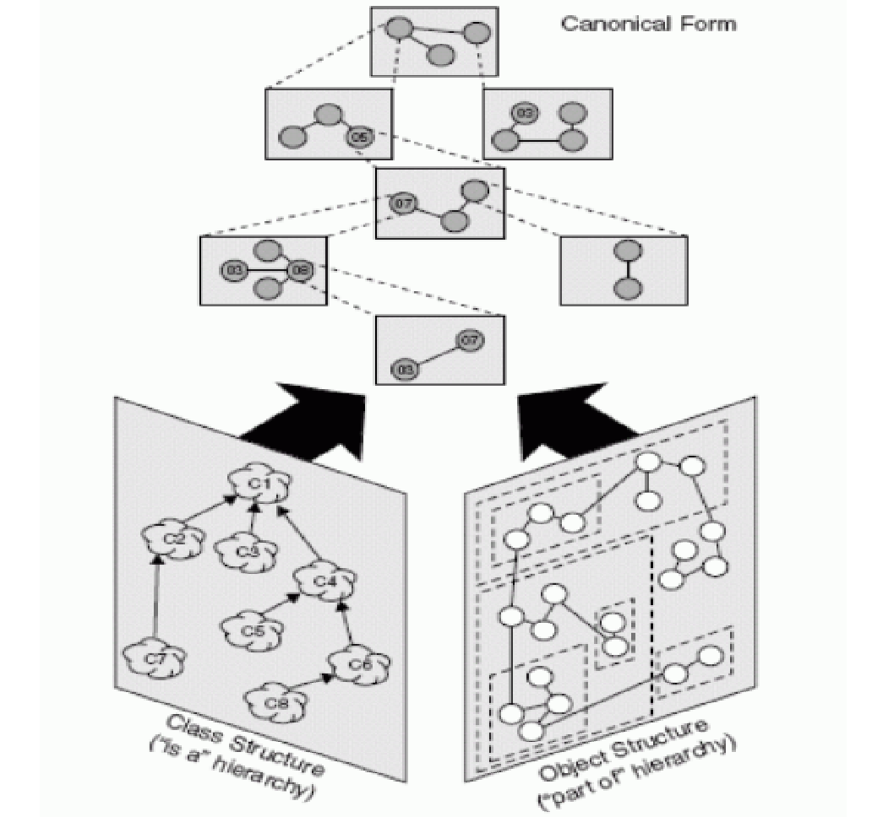
Canonical Form of a Complex System

Slide 18
Disorganized complexity
Human beings
maximum chunks of information that an individual can simultaneously comprehend is on the order of seven, plus or minus two
short-term memory
processing speed is limited - mind take 5 sec to accept new chunk of information

Slide 19
Successful Complex Software Systems
Exhibit the following attributes characterizing good complex systems.
Have well designed and built class and object structures
captures common features and behaviour within a system
Illustrates how different objects collaborate with one another

Slide 20
Benefits and challenges OOAD can address
Among the many claimed benefits of OO systems are faster development, higher quality, easier maintenance, reduced costs, increased scalability, better information structures, and increased adaptability.
One of the primary reasons for these claims is that OO approaches control complexity of a system by supporting hierarchical decomposition through both data and procedural abstraction.
The complexity of OO systems can be represented by a set of measures defined at different levels.
For OO systems, the software complexity of OO systems are described at four levels:
variable,
method,
object, and
system.
E. Da-wei, "The Software Complexity Model and Metrics for Object-Oriented," 2007 International Workshop on Anti-Counterfeiting, Security and Identification (ASID), Xiamen, Fujian, 2007, pp. 464-469,

Slide 21
Variable level complexity is associated with the definition and use of variables throughout the system.
Method level complexity is associated with the definition and use of methods throughout the system.
Object level complexity combines variable and method complexity with measures of the inheritance structure.
System level complexity provides high level representations of OO system size and organization.
At each level, measures are identified to account for the cohesion (intra) and coupling (inter) aspects of the system at that level.
The measures account for both procedural and data characteristics of an OO system, and are applicable throughout the lifetime of an OO system.
E. Da-wei, "The Software Complexity Model and Metrics for Object-Oriented," 2007 International Workshop on Anti-Counterfeiting, Security and Identification (ASID), Xiamen, Fujian, 2007, pp. 464-469,

Slide 22
Key references
Object-Oriented Analysis and Design with Applications-Third Edition-Addition Wesley Authors-Grady Booch Robert A. Maksimchuk Michael W. Engle Bobbi J. Young, Ph.D. Jim Conallen Kelli A. Houston

Slide 23
Thank You

